Slide 1
VSMUG 2020-10
Justin Chalfant - Intro
https://vsmug.com/
https://vsmug.com/youtube

Slide 2
VSMUG – Who We Are and Getting Involved!
Our Website 🌐 - https://vsmug.com/
Subscribe to Events - https://vsmug.com/subscribe
Submit a Session - https://vsmug.com/session-submission
Playback of Session 🎥 - https://vsmug.com/youtube
Slides / Example Content - https://vsmug.com/github
Survey (Open Now ☺) - https://vsmug.com/feedback

Slide 3
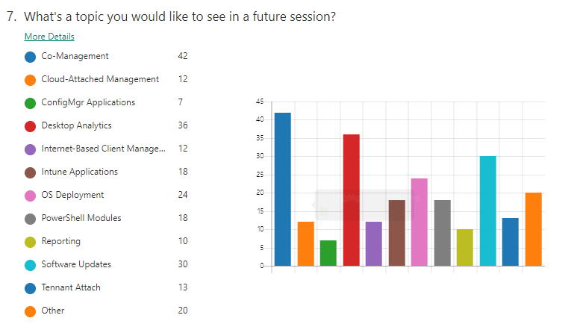
VSMUG 2020-06 Feedback

Slide 4
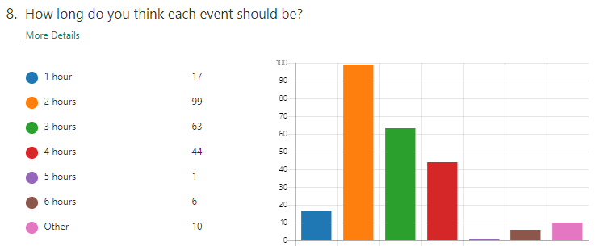
VSMUG 2020-06 Feedback

Slide 5
Deep Dive: V3 Driver Catalogs
Justin Chalfant
Andrew Jimenez

Slide 6
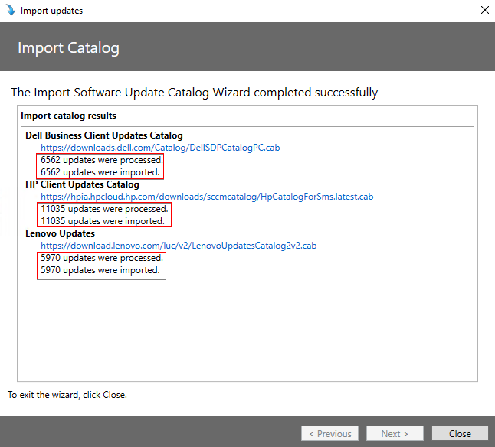
Wow That’s A Lot of Updates 😲
Notes:
Justin

Slide 7
3rd Party Catalog Revisions
V1
Single Monolithic Catalog
All updates are defined in a single XML
V2
Adds an .sdp file for each update and an update manifest
Adds bundled certificates
Improves SCUP processing speed and security
V3
Adds categories
“update_categories.json” file that lists each update category ID
JSON file defines each category
Notes:
Andrew

Slide 8
SCUP/ConfigMgr Catalog Evolution – V1
SCUP 2011 and earlier
The Bad
It’s a 100% manual import and publishing process using SCUP
Catalog import is very slow for large catalogs
Certificates are not included in the update catalog
The Good
Publish third-party updates to WSUS
Easily import partner catalogs
Dell, HP, Lenovo, Adobe, Etc.
Notes:
Justin

Slide 9
Demo – V1 Catalog Using SCUP 2011
Notes:
Demo V1 catalog subscribe and import: (Justin)
DEMO on DEMO3
Disadvantages to V1
Manual import every time you want to import the latest catalog
Manually publish any new update you want to make available in WSUS/ConfigMgr

Slide 10
SCUP/ConfigMgr Catalog Evolution – V2
Updates Publisher (2017 -6.0.276.0) - ConfigMgr 1806
The Good
Better support for ConfigMgr publishing (Adds content certificates)
Faster imports for large catalog when using SCUP
The Bad
When using ConfigMgr, you can’t selectively choose updates to publish
No automated full-content publishing support in ConfigMgr
Can’t be fully automated
Notes:
Andrew

Slide 11
SCUP/ConfigMgr Catalog Evolution – V3
Updates Publisher (2019 – 6.0.394.0) - ConfigMgr 1910
The Good
Now supports categories for selective publishing
Can be fully automated with full-content publishing
Notes:
Andrew

Slide 12
Moving from a v2 to v3 catalog
Resubscribe to the catalog
Decline updates that do not belong in any categories
Run WSUS cleanup
Use Scheduled Sync
Choose new categories
Notes:
Andrew

Slide 13
Vendor Specific Info
Dell requires an agent installed on each client
Dell OpenManage Inventory Agent
Creates WMI classes used in applicability rules
Dell added V3 catalog support in March 2020
Lenovo requires an agent as well
https://support.lenovo.com/uu/en/solutions/ht510591
Lenovo added V3 catalog support in June 2020
HP do not require a client
Utilize built-in WMI classes to build applicability rules
HP added V3 catalog support in August 2020
Notes:
Andrew

Slide 14
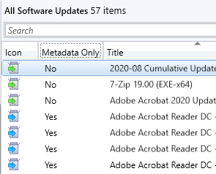
Update Download States
Metadata-Only Updates
The metadata for updates in WSUS contains all the information about an update, and they appear in the console with a blue icon next to them.
WSUS Update Metadata includes information such as:
Title, Description, Update Severity, Update Classification, Superseded Updates
Applicability Rules
IsInstalled, IsSuperseded, IsInstallable
Command Line
Return Code Behavior
Full Content Updates
Same as Metadata, but also published the update binary
https://patchmypc.com/what-are-metadata-only-updates-and-how-to-deploy - Detailed KB
Notes:
Justin

Slide 15
Demo V3 Catalog Features in ConfigMgr
Notes:
DEMO2|2
Show enabling 3rd party patches – Justin
Show catalog download, and available catalogs after enabling
Mention to check Features node if you don’t see third-party updates tab in SUP
Review manage cert options and gotchas – Justin
DEMO3|2
Show catalogs being downloaded (ISV) – Justin
DEMO3|1
Configure Dell catalog – enable 1 or 2 categories - Andrew
Show content staging - Andrew
Sync (Show ISV and wsyncmgr) – Andrew
DEMO1|2
Declining of updates not in a category – script - Andrew
DEMO3|2 (Time Filler)
WSUSContent / UpdateServicesPacks Cleanup – Justin (Run this on SCCM 150 Declined Updates to Delete)
"C:\Program Files\Update Services\Tools\WsusUtil.exe" listunreferencedpackagefolders
Show Adobe v1 catalog warning - Justin
Enable Product – Adobe - Justin

Slide 16
Tips for 3rd party driver update catalogs
Only import categories that are necessary
Vendor catalogs can contain over 5000 updates!
Choose your top 3-5 models and import drivers from those models only
Turn on the WSUS cleanup options within ConfigMgr
Or run one of the popular WSUS cleanup scripts regularly
WSUS performs better with fewer updates!
SUP scans complete faster
Client-side update scans complete faster
Notes:
Andrew

Slide 17
Questions?

